Slide 1



first_report
View in Power BI
Last data refresh:
4/24/2023 4:12:54 AM UTC
Downloaded at:
4/25/2023 2:25:31 PM UTC

Slide 2
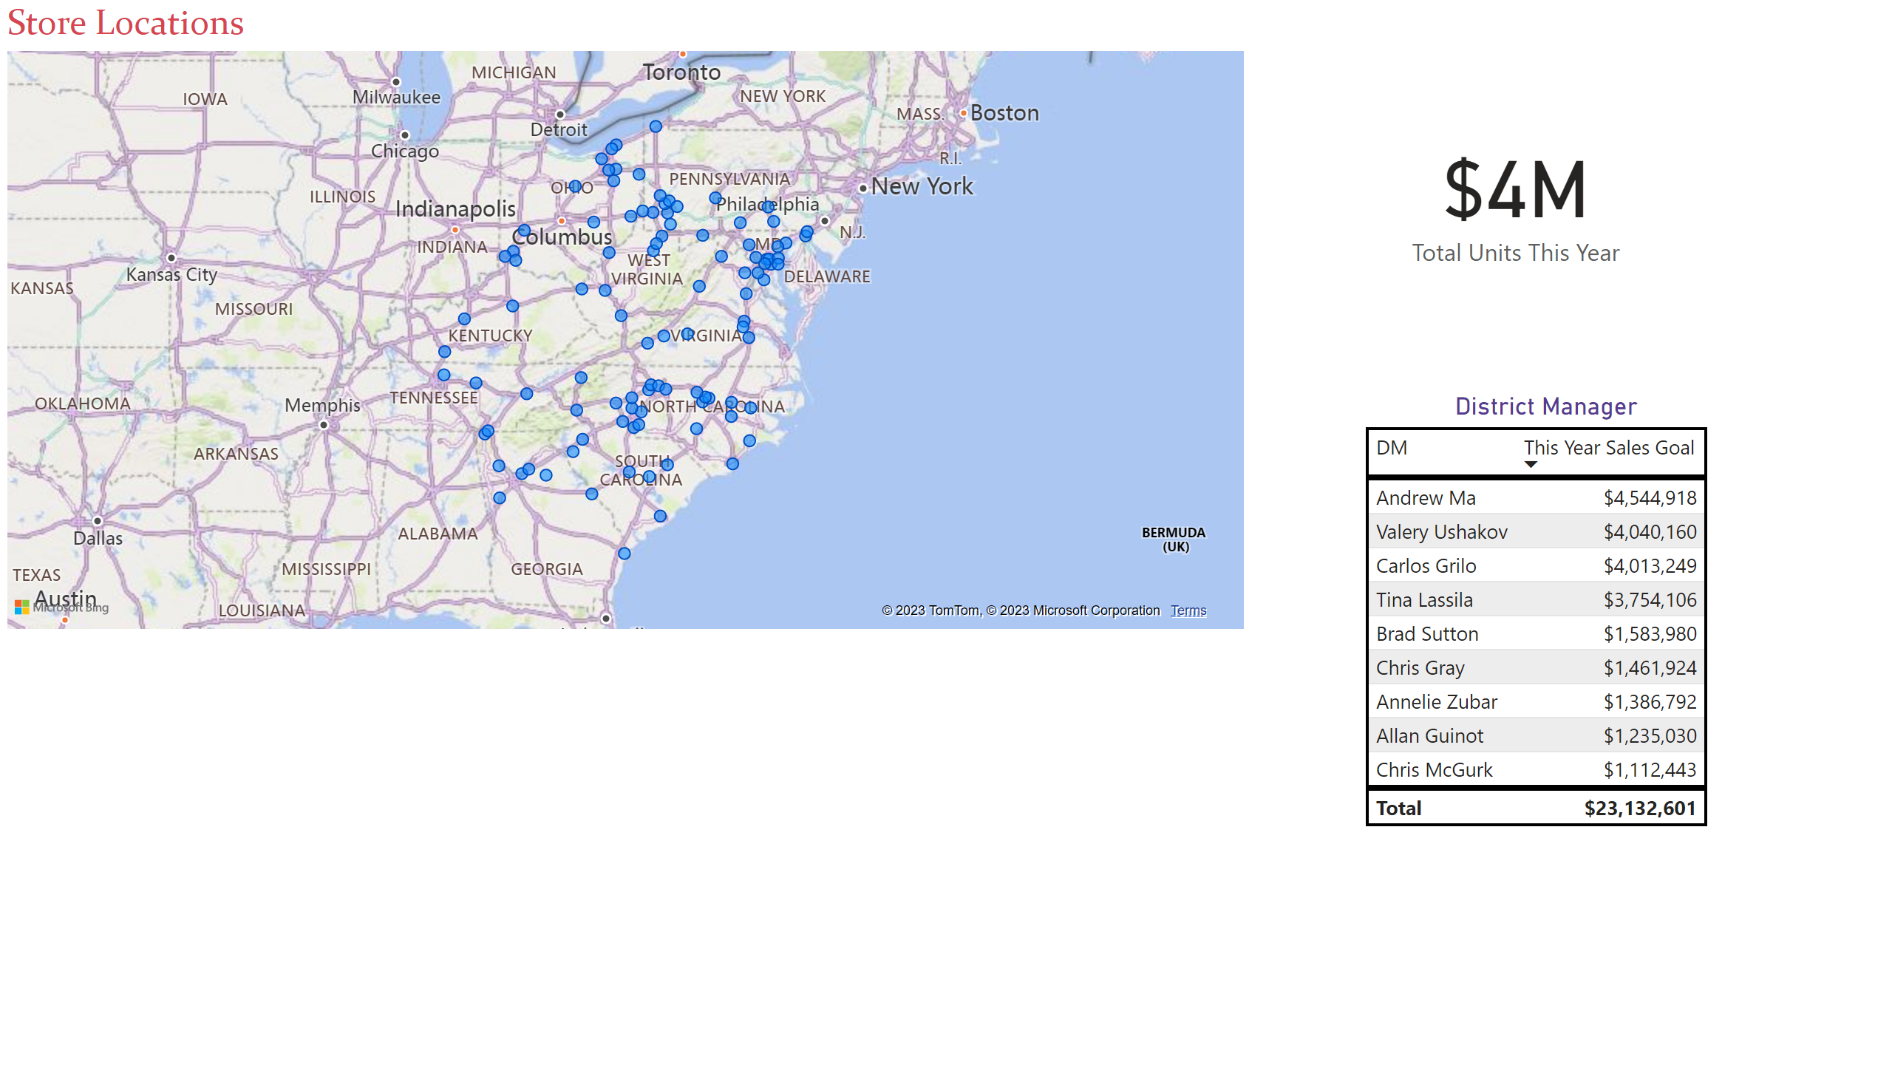
Page 1
Notes:
District Manager
No alt text provided
Store Locations
No alt text provided
card
No alt text provided

Slide 3
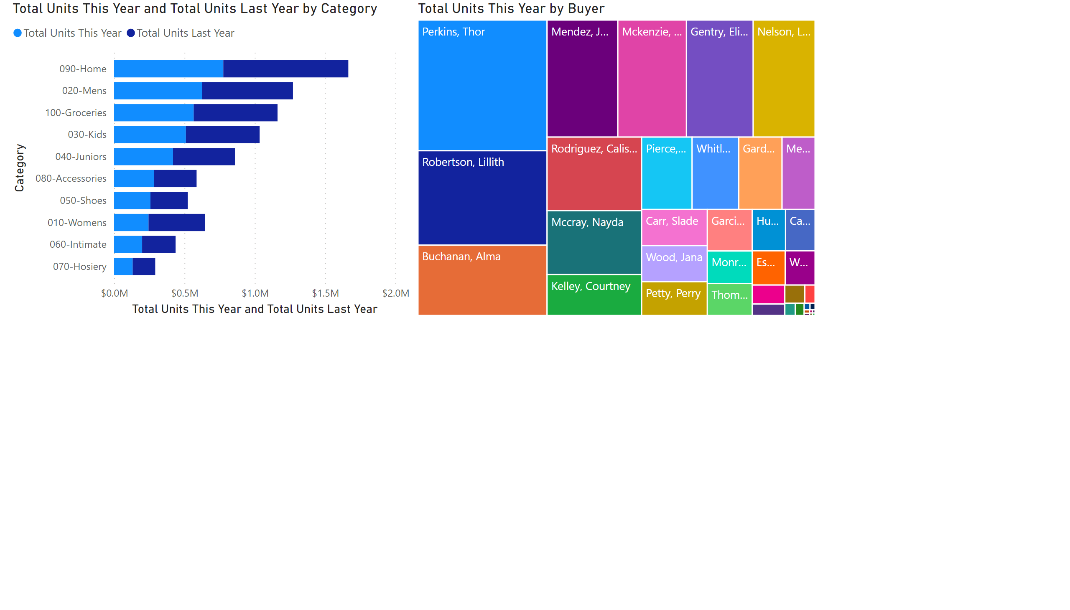
Page 2
Notes:
treemap
No alt text provided
barChart
No alt text provided

Slide 4
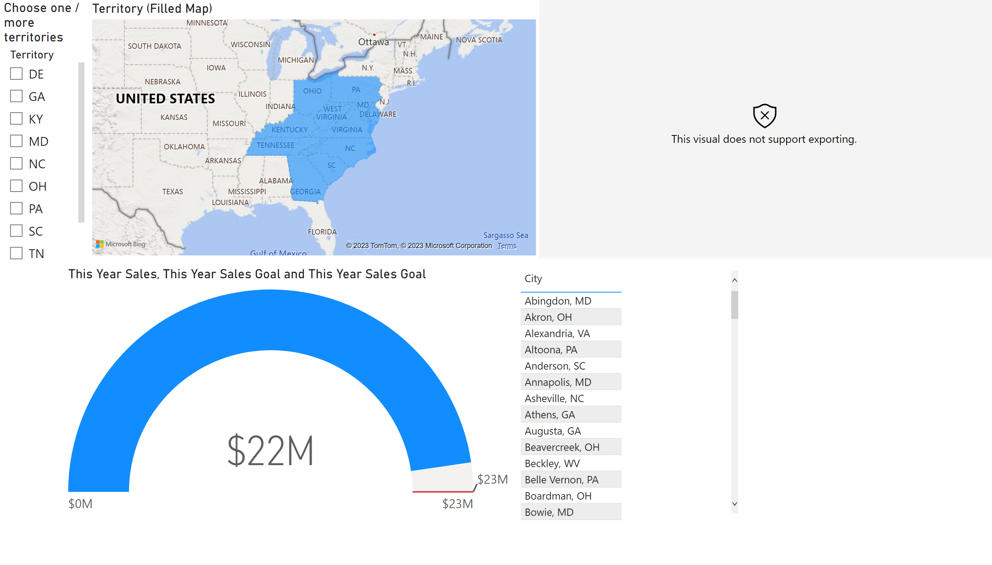
Territories
Notes:
gauge
No alt text provided
City (ArcGIS)
No alt text provided
Territory (Filled Map)
No alt text provided
Choose one / more territories
No alt text provided
tableEx
No alt text provided

Slide 5

Page 3
Notes:
cylindricalGauge73A12A442345453EB69B593649C3A341
No alt text provided

